Slide 1
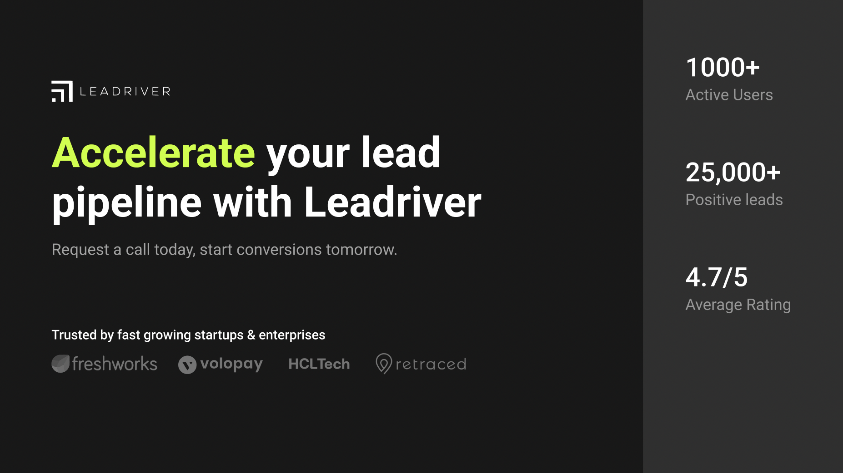

Slide 2
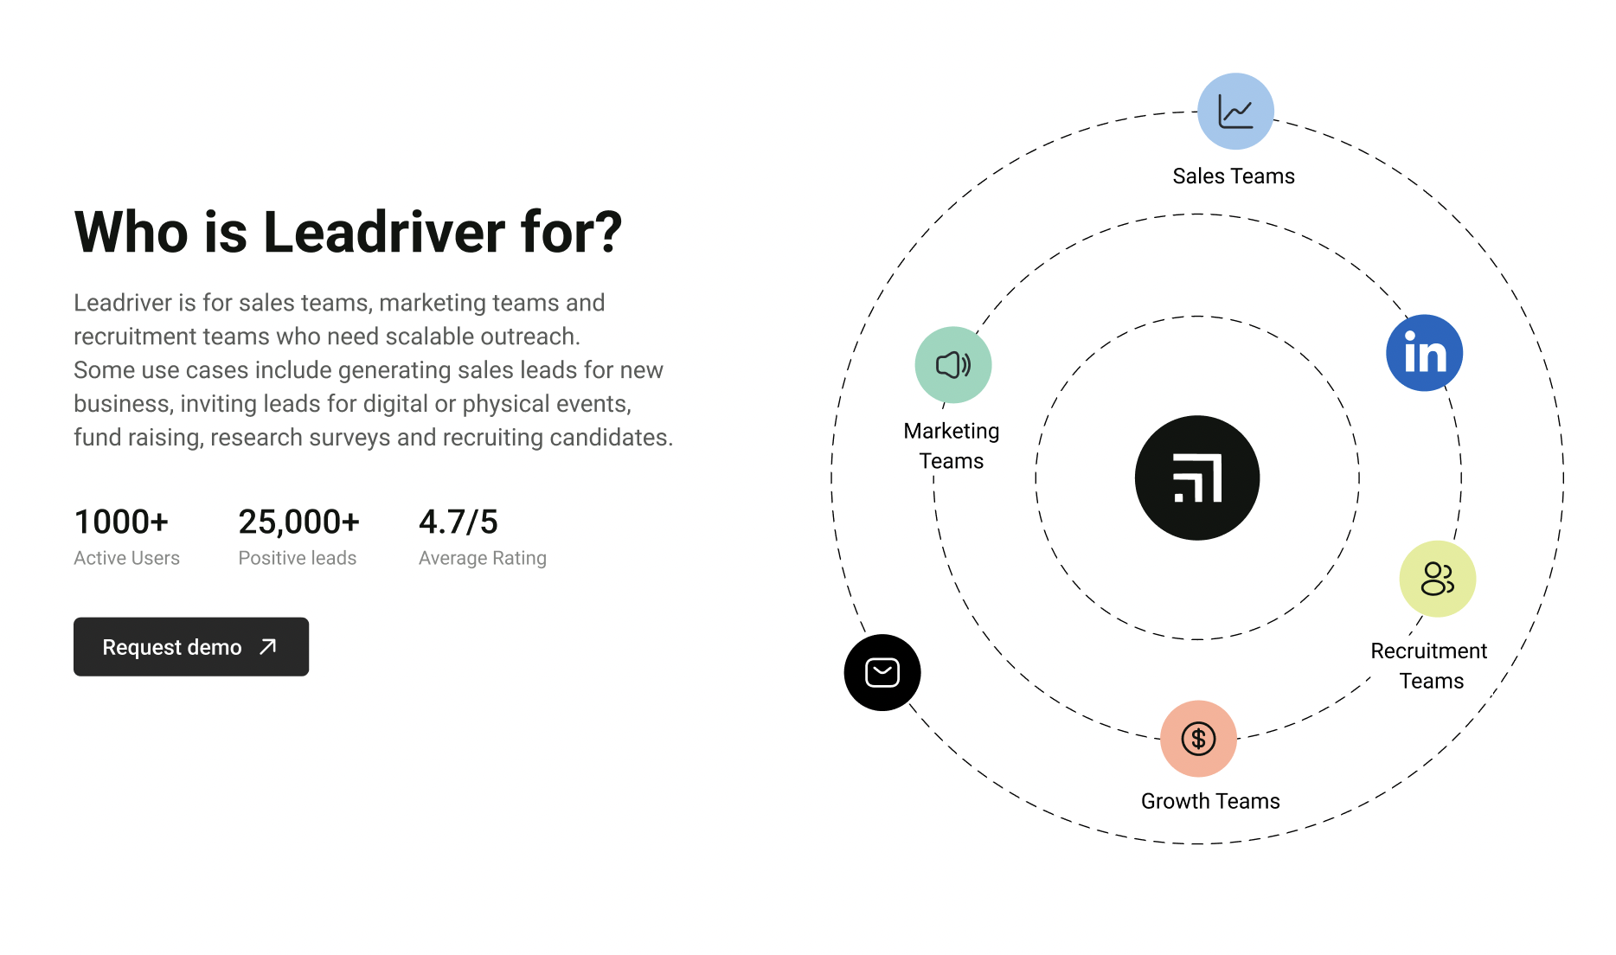
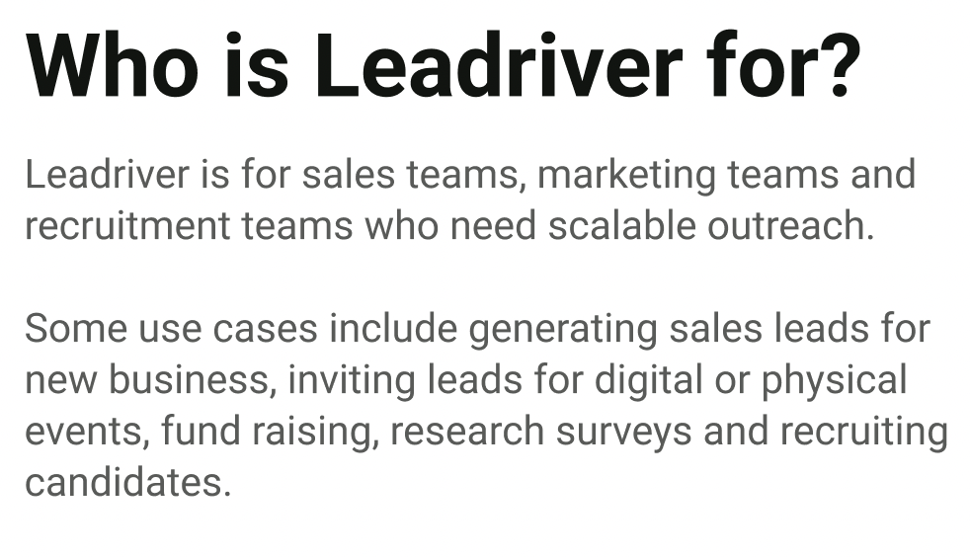


Slide 3
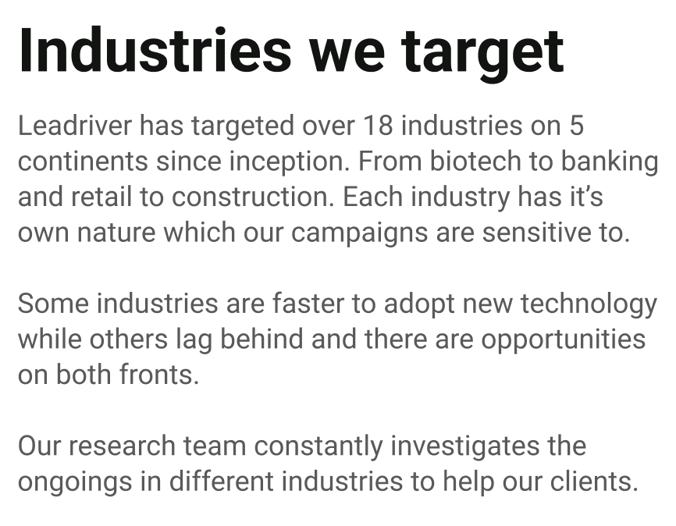
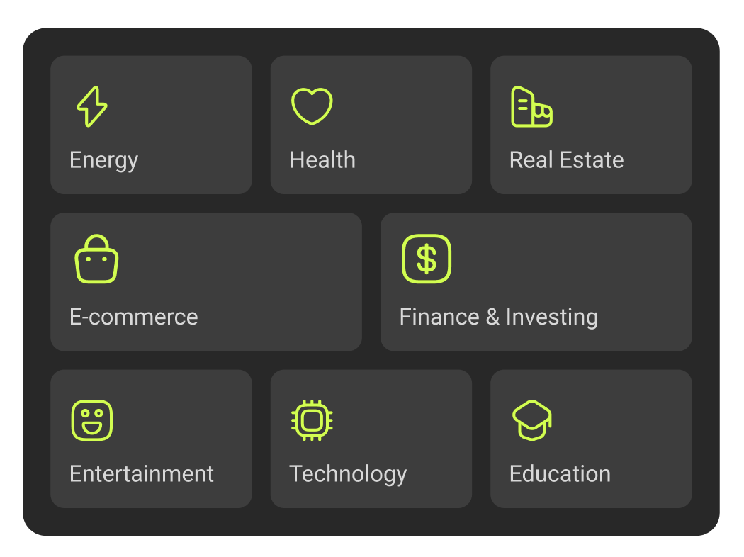

Slide 4
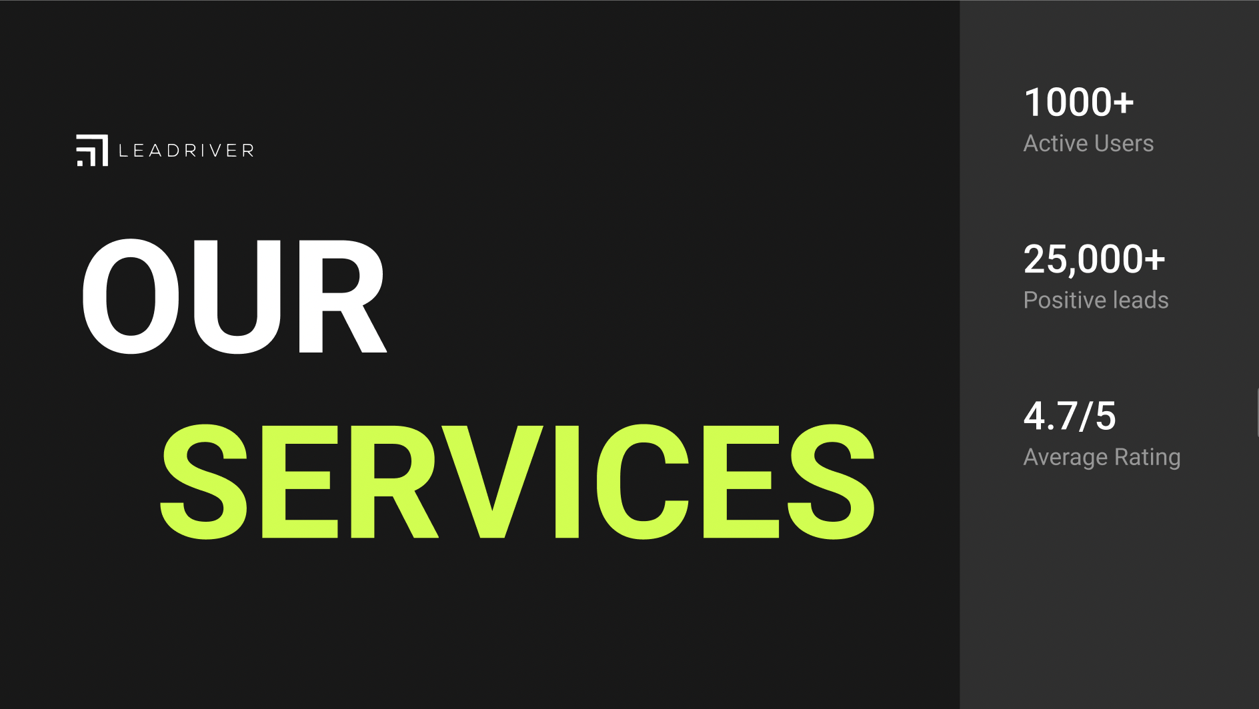

Slide 5
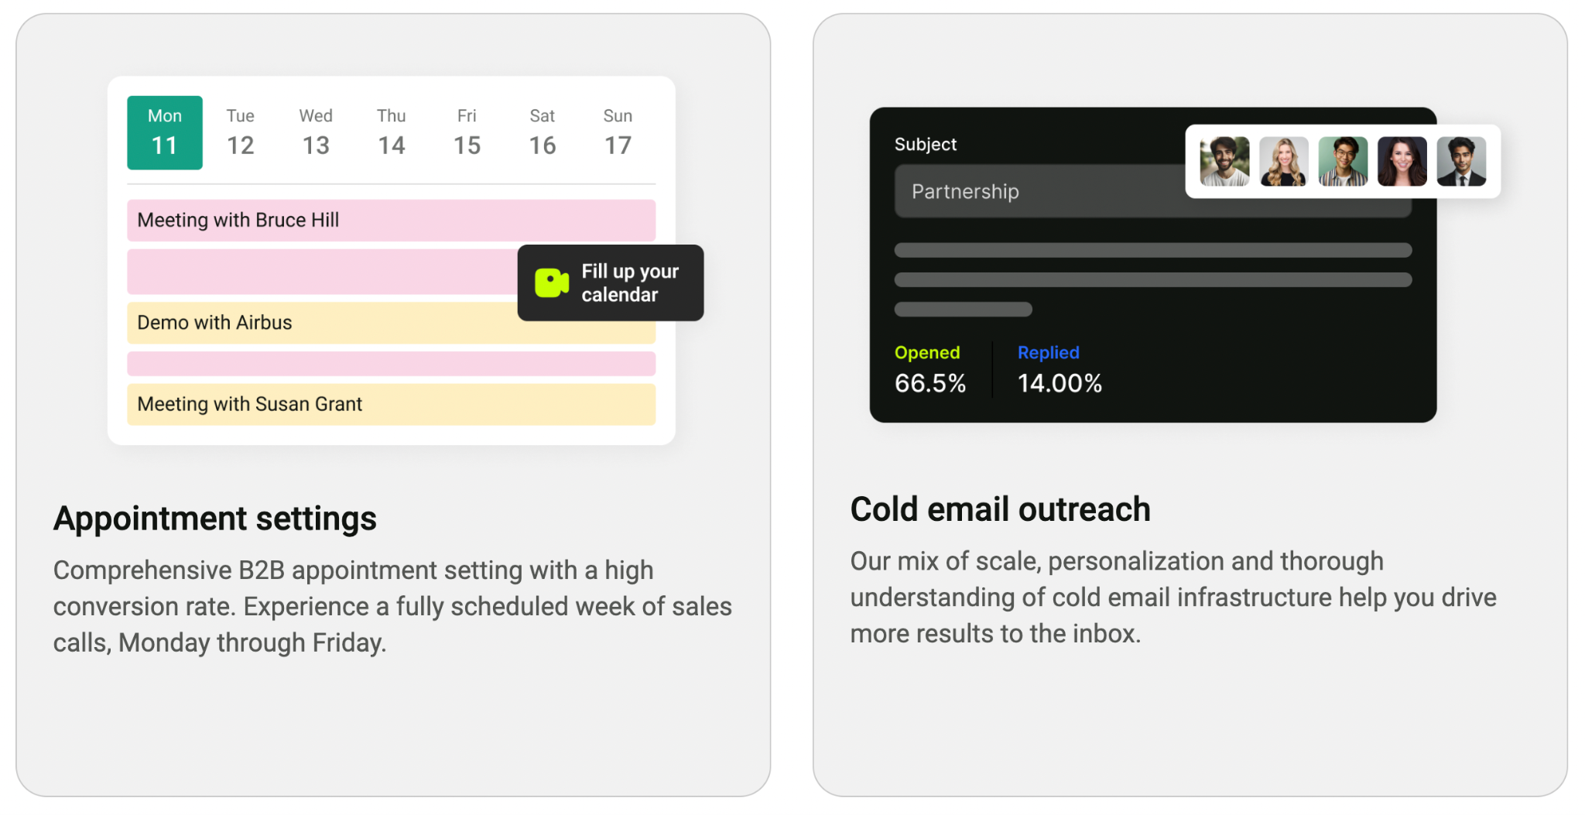

Slide 6
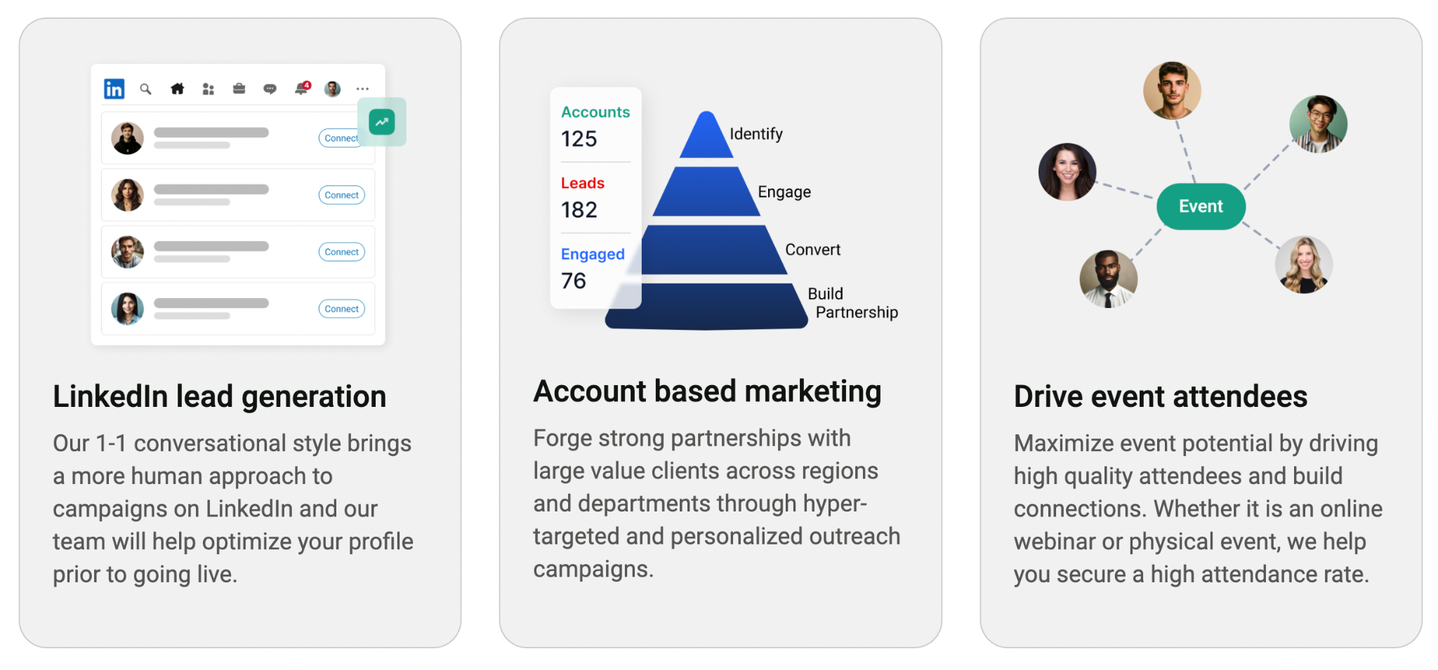

Slide 7
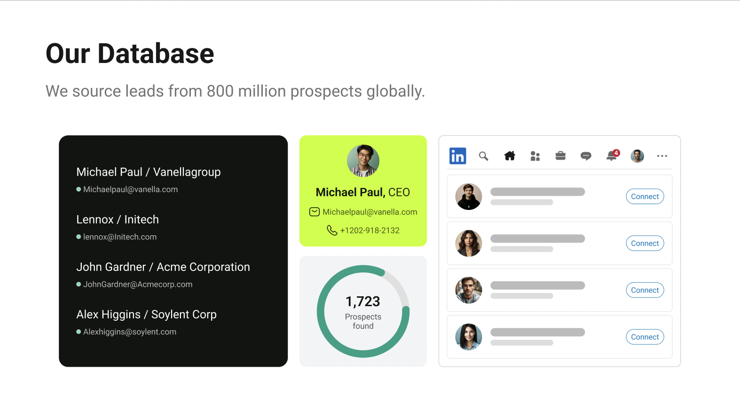

Slide 8
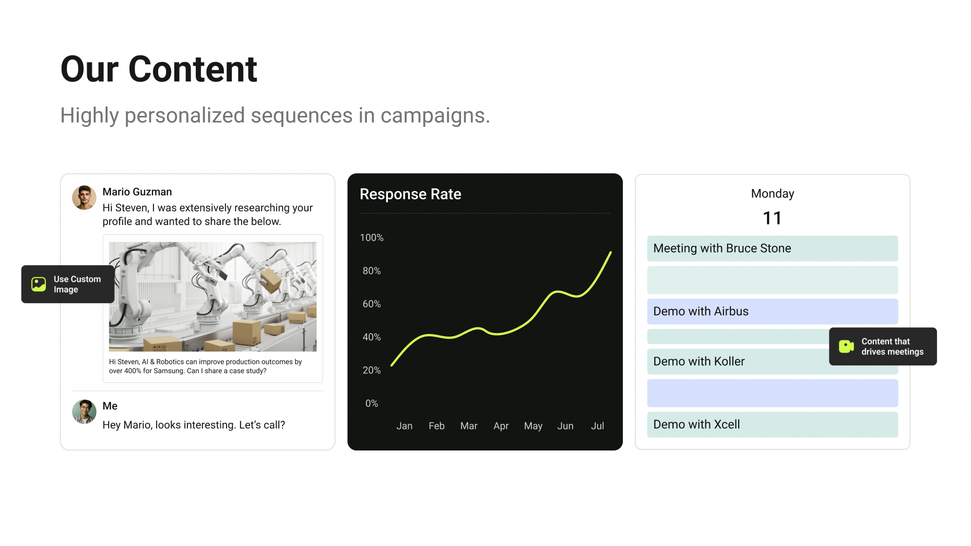

Slide 9
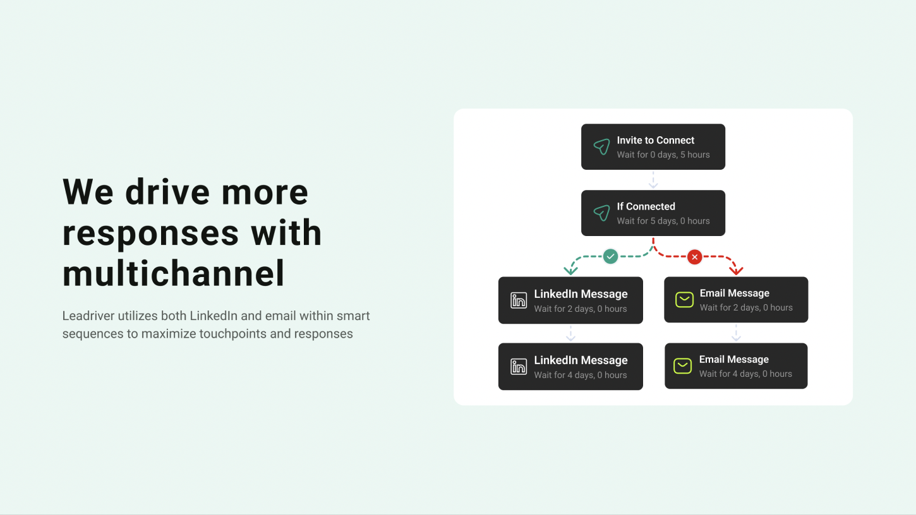

Slide 10
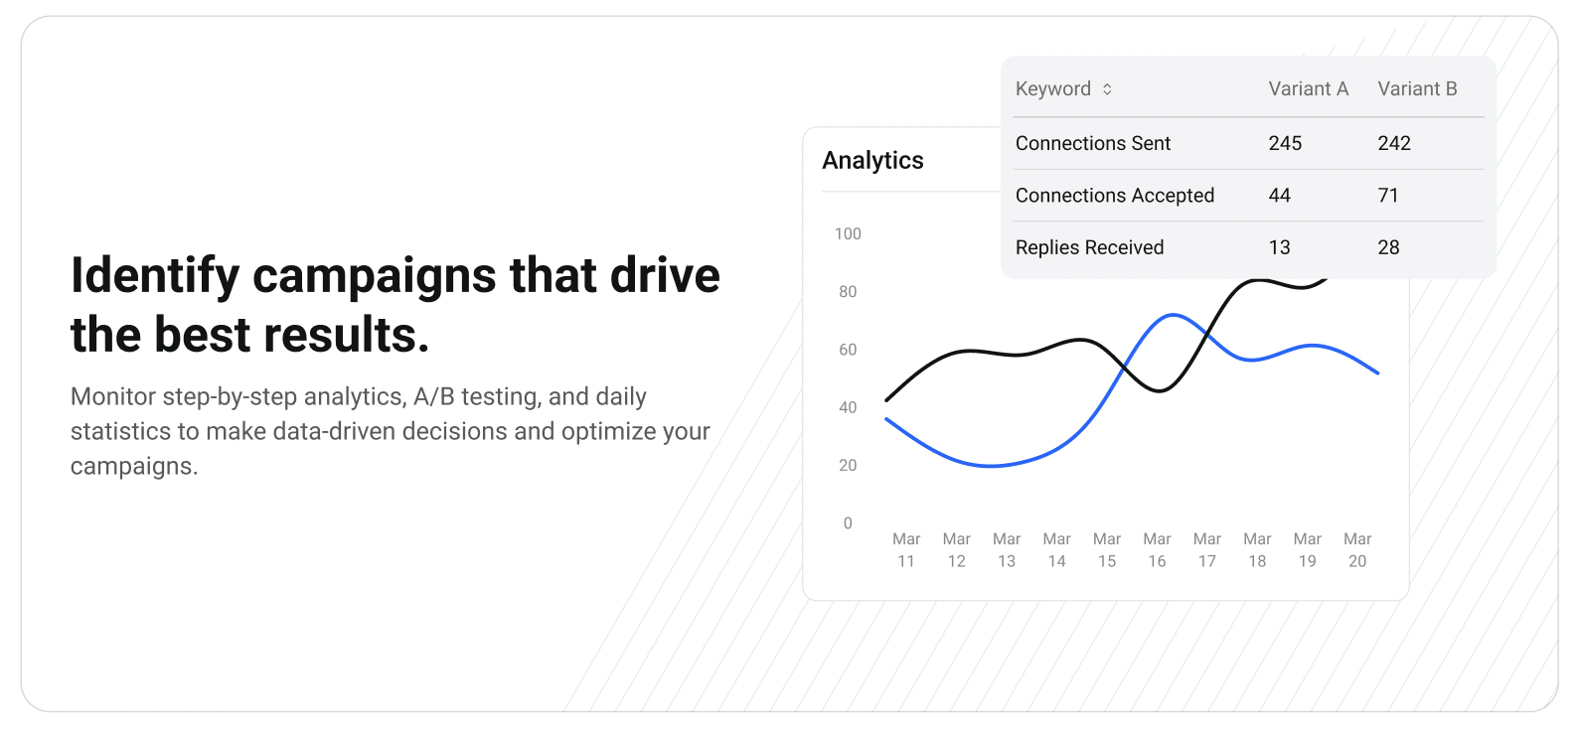

Slide 11
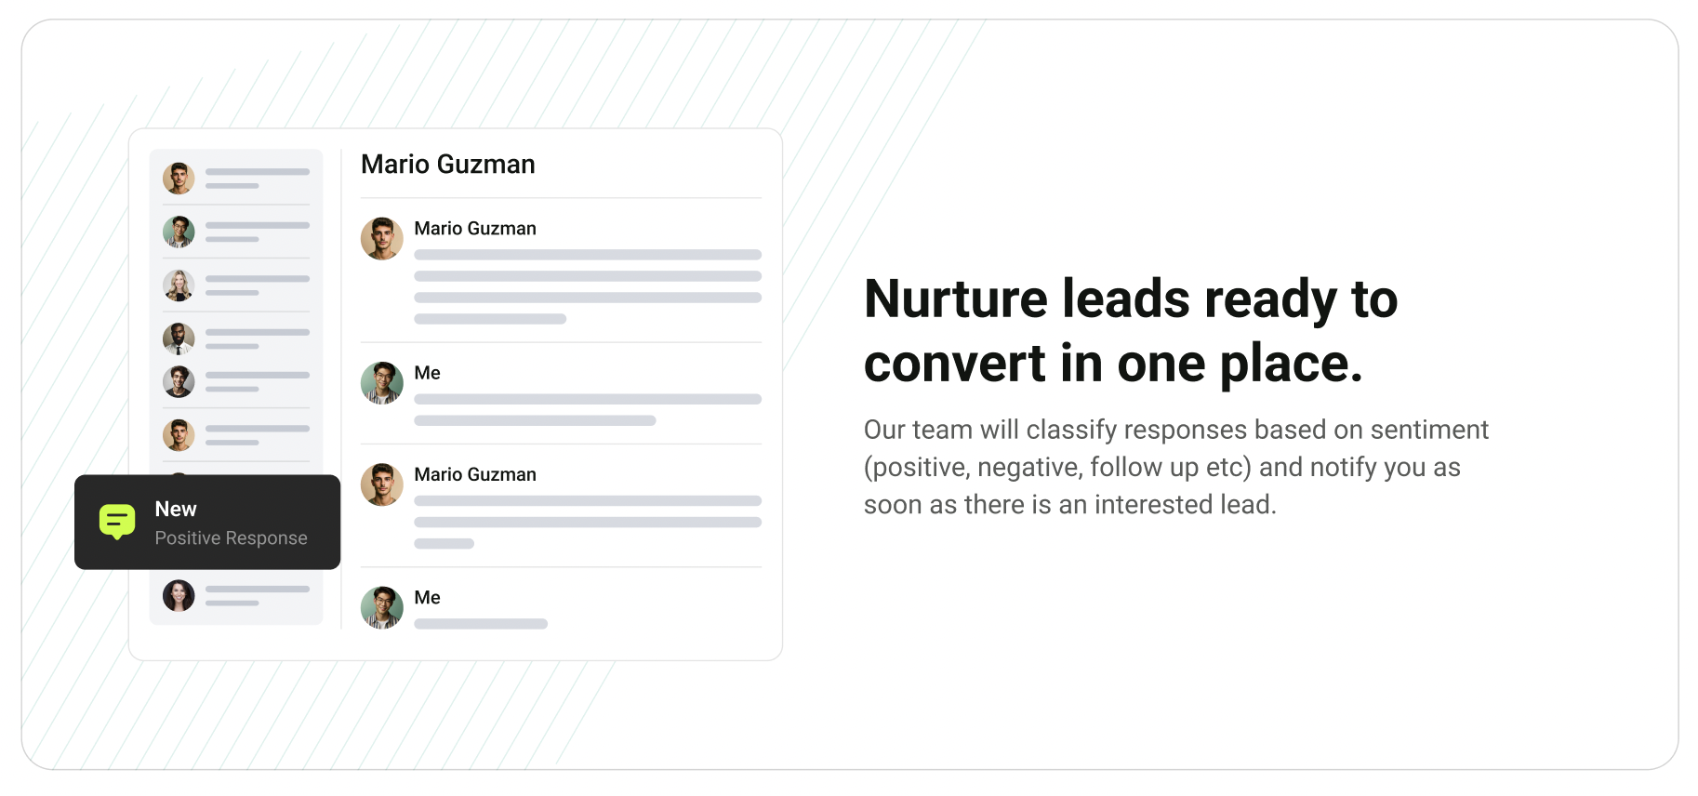

Slide 12
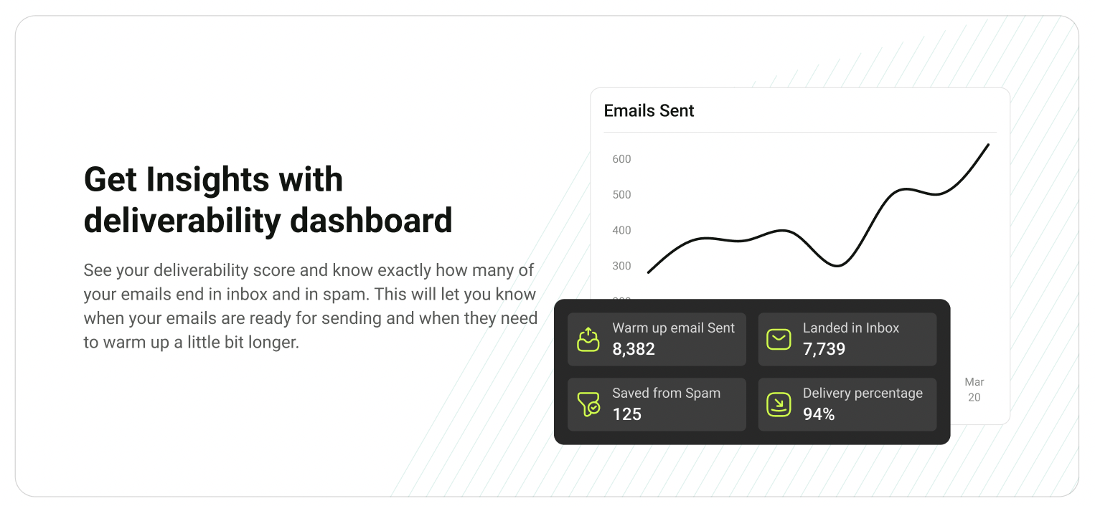

Slide 13
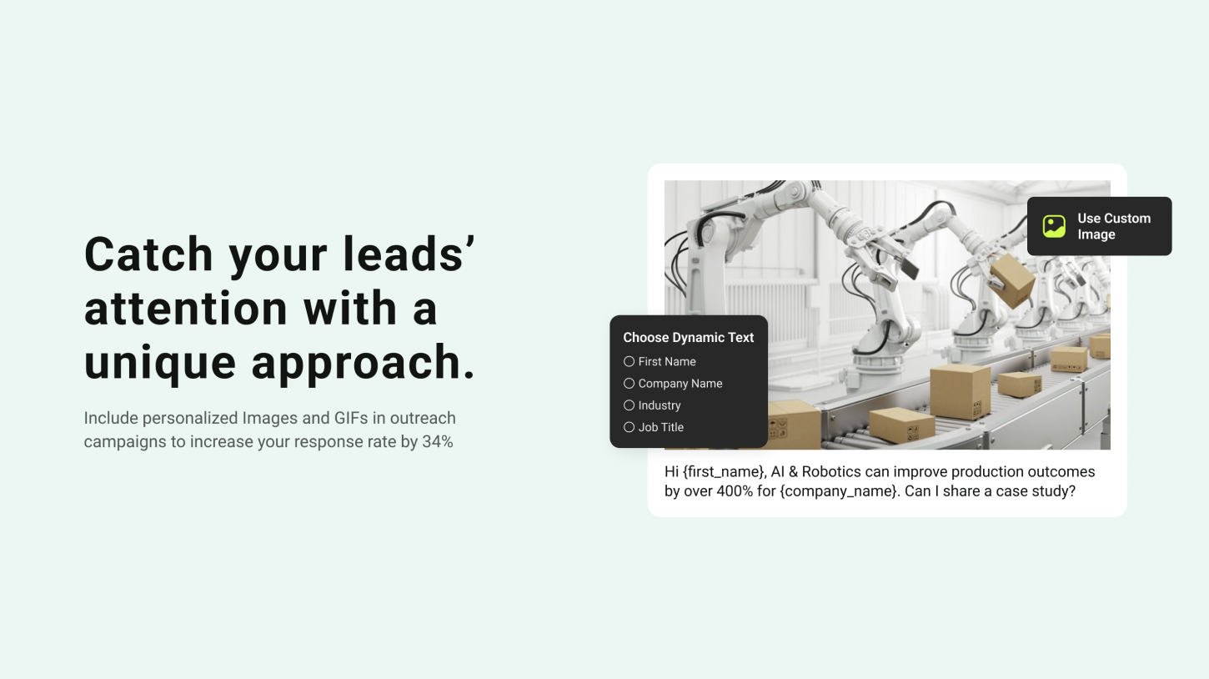

Slide 14
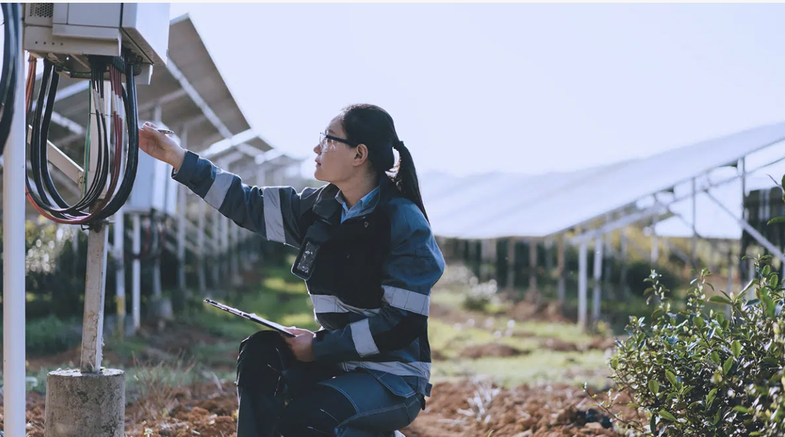


Customer Examples
Personalized firstname
Tom, we’d love to prove how our IoT enabled solutions can decrease energy consumption at Schiphol Airport by 15% - 20%.
Are you open to a showcase?
Personalized
company name

Slide 15
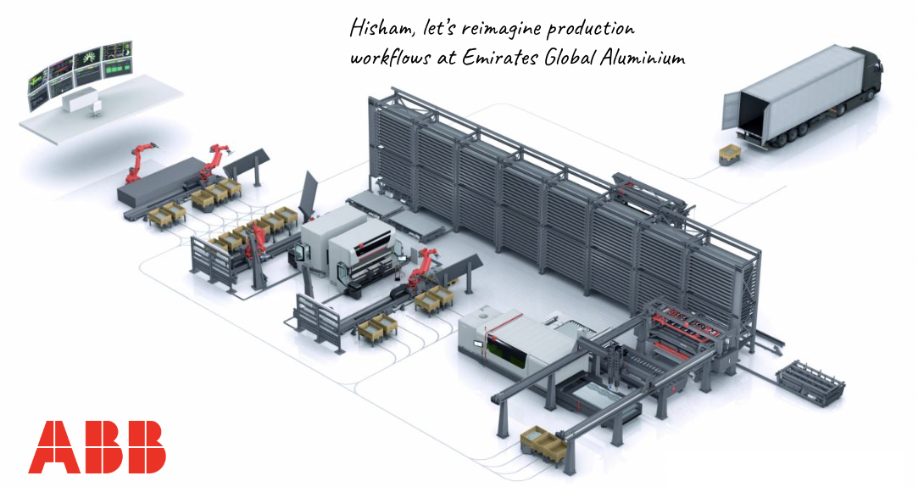
Customer Examples
Personalized firstname
Personalized company name

Slide 16
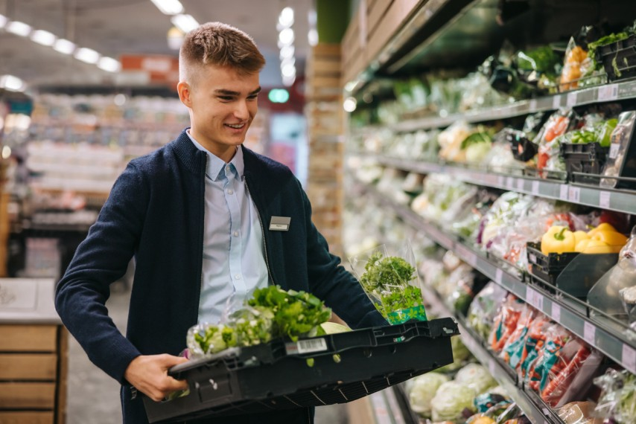

Customer Examples
Personalized firstname
Hi Sven, demand forecasting is fundamental to retail planning.
We’ve built AI models that can help Tesco improve by 3-5% based on previous executions.
Can I send you some info?
Personalized company name

Slide 17

Customer Examples
Personalized image
Personalized firstname
Personalized company name

Slide 18
